Slide 1


Process Mining: Managing Complexity through Hierarchical Analysis
A systematic approach to handling large-scale process data for effective business analysis

Slide 2

The Complexity Challenge in Process Mining
Data Volume
"Spaghetti" Models
Modern business processes generate thousands of events across hundreds of variants, creating overwhelming complexity
Unfiltered process maps become visually incomprehensible with too many connections, resembling tangled spaghetti
Analytical Barriers
Excessive detail makes meaningful pattern identification, bottleneck detection, and comparative analysis nearly impossible

Slide 3
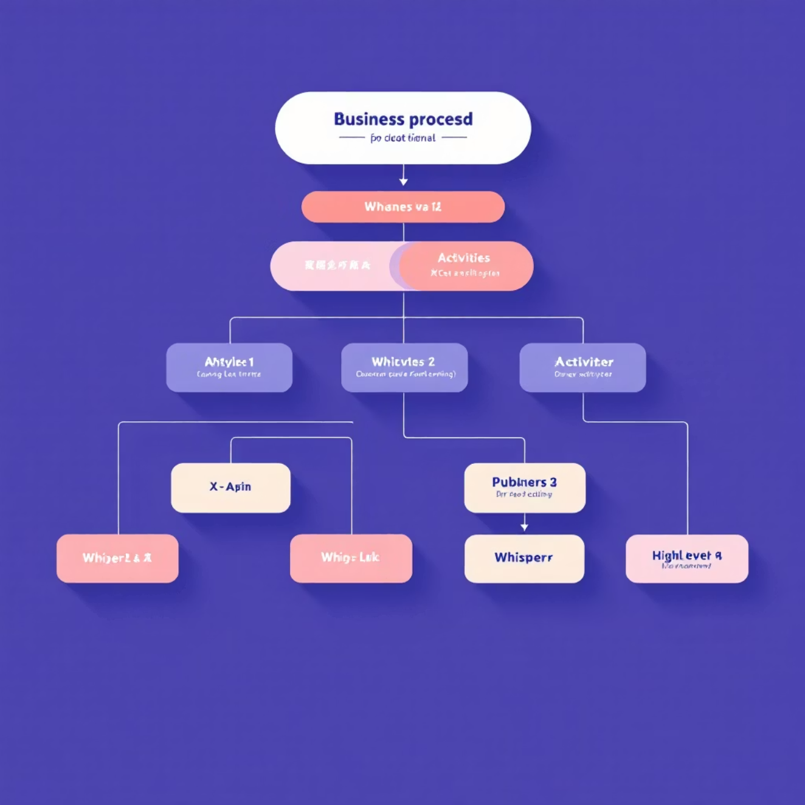
The Power of Hierarchical Process Organization
Complex business journeys can be systematically decomposed into manageable levels:
End-to-End Journey
The complete customer or operational path from start to finish
Major Processes
Primary functional blocks (e.g., Onboarding, Fulfillment, Support)
Sub-Processes
Component workflows within major processes
Activities
Individual tasks and events at the most granular level

Slide 4

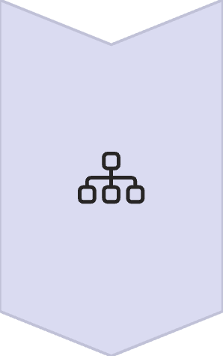

Levels of Abstraction: From General to Specific
Level 1: Strategic View
High-level business activities capturing the essential flow (5-10 activities)
Example: Application → Review → Approval → Fulfillment
Level 2: Tactical View
Mid-level business processes with more operational detail (10-25 activities)
Example: Application becomes Application Form → Document Upload → Initial Screening
Level 3: Operational View
Detailed system and user interactions capturing all recorded events (25+ activities)
Example: Each document upload becomes multiple system events

Slide 5

Variant Explosion Problem
Without proper abstraction, variant counts grow exponentially:
10
25
Activities
Activities
Can generate dozens of variants
Can generate hundreds of variants
50+
Activities
Can generate thousands of variants
Each minor path deviation creates a new variant, making comparative analysis impossible at scale.

Slide 6
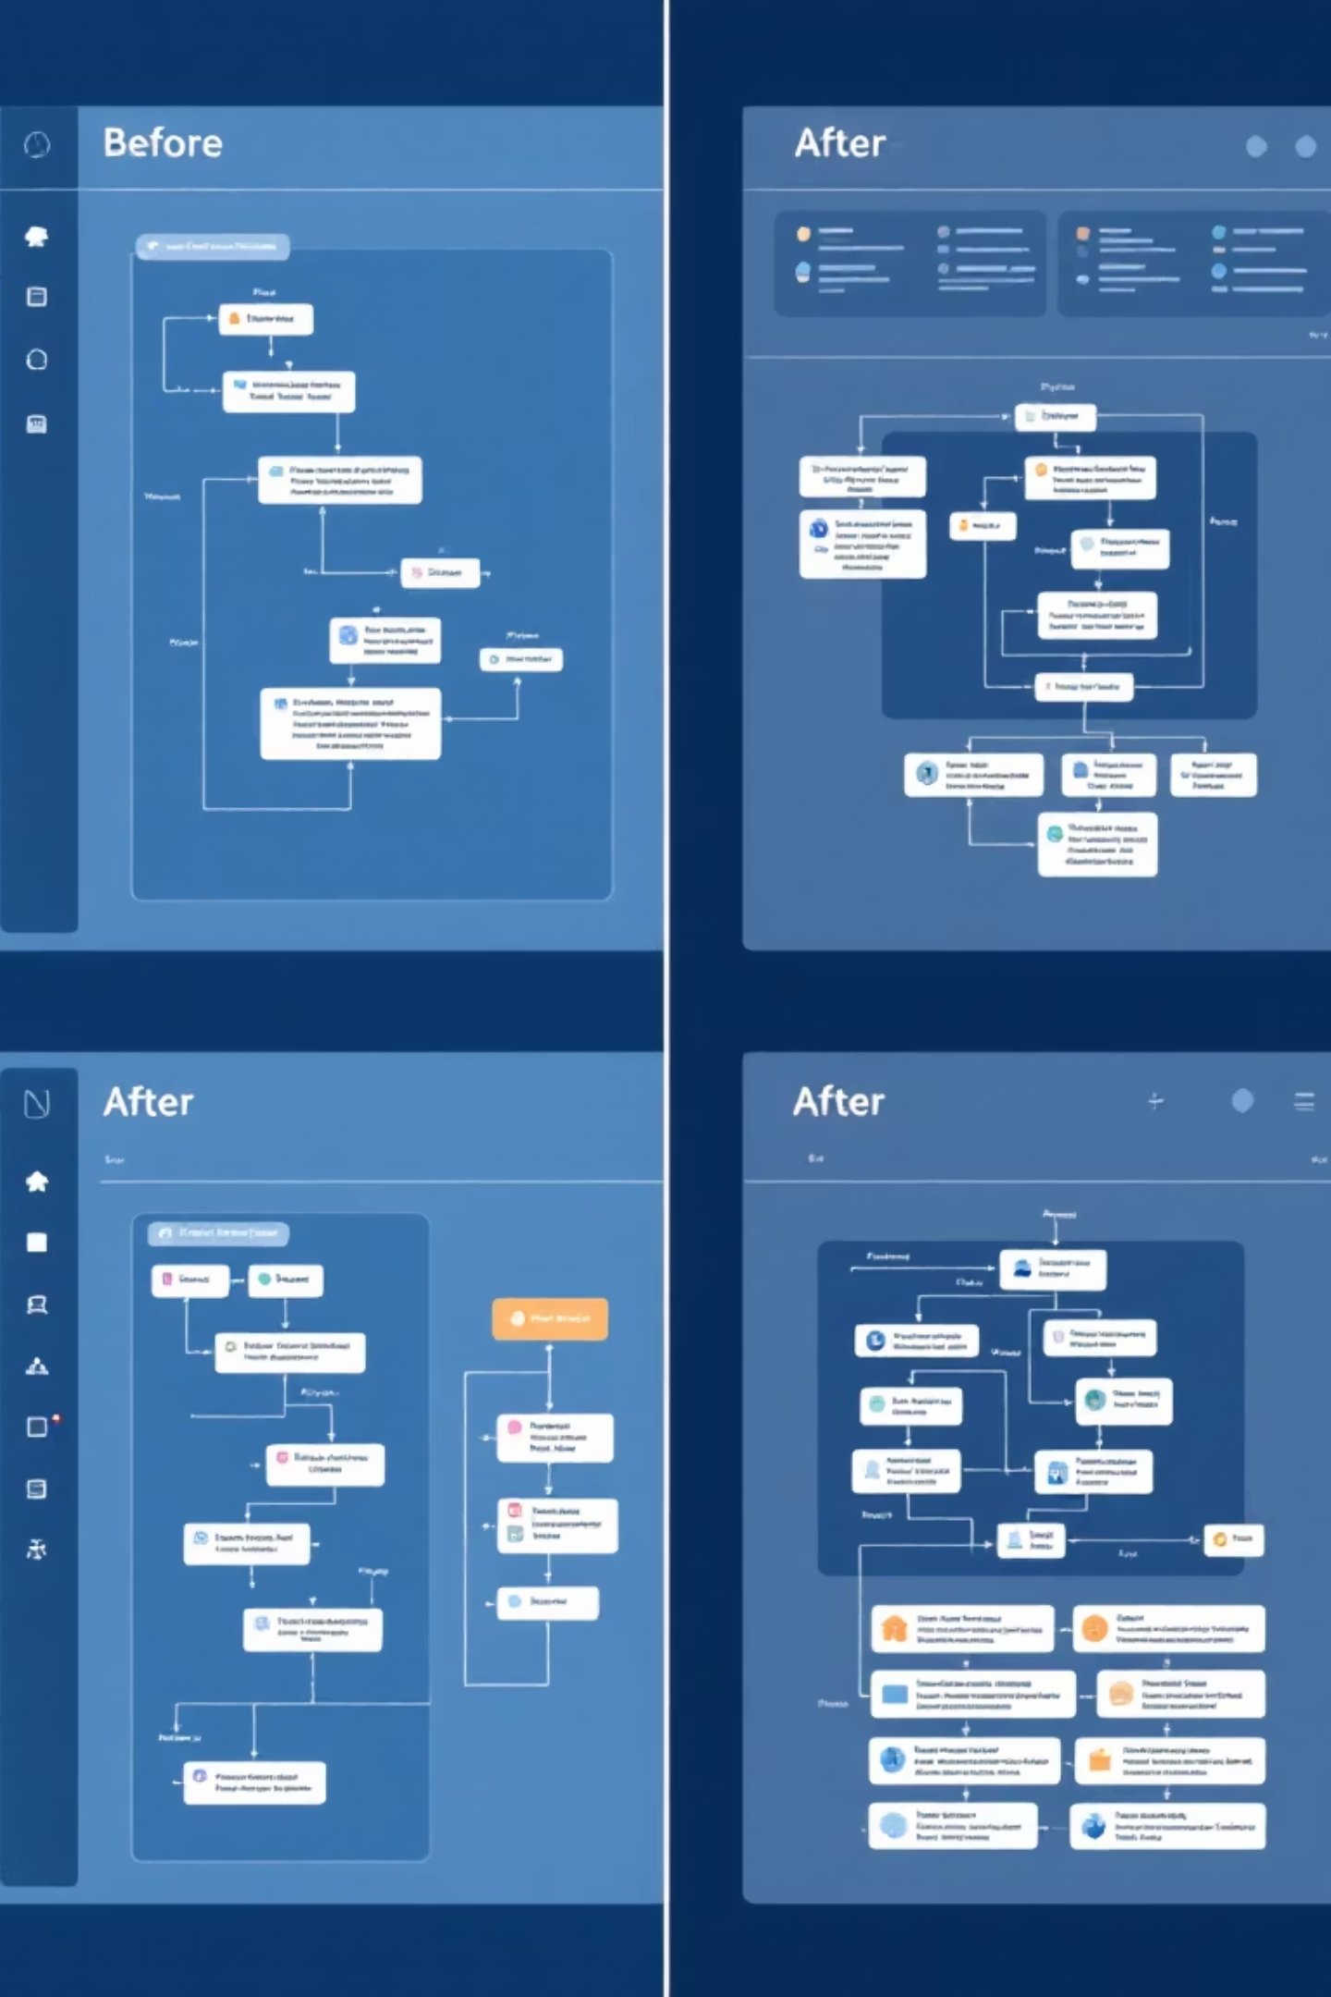
Activity Grouping Strategies
1
2
Functional Grouping
Sequential Clustering
Combine activities based on business function (e.g., all validation steps)
Group activities that frequently occur together in sequence
Reduces complexity while maintaining business meaning
Captures natural process flows
Can be algorithmically detected
Aligns with organizational structures
3
Outcome-Based Grouping
Organize by activities that contribute to the same outcome
Focuses on business results
Highlights value-adding vs. non-value-adding steps

Slide 7

Focused Variant Analysis
The Problem with Ungrouped Analysis
Benefits of Hierarchical Analysis
When analyzing all activities at once:
When analyzing at appropriate levels:
Top variants may each represent <1% of cases
Top variants represent significant case percentages
Meaningful patterns get lost in noise
Clear patterns emerge at each level
Performance metrics become diluted
Performance bottlenecks become visible
Improvement opportunities remain hidden
Targeted improvements become possible

Slide 8












Iterative Process Discovery
Initial Process Discovery
Activity Filtering
Generate high-level process model
Apply grouping strategies
Model Refinement
Variant Analysis
Improve abstraction levels
Identify significant process paths
Performance Analysis
Hierarchical Drilling
Measure KPIs at each level
Explore sub-processes
Continuously refine process models through iterative discovery at different abstraction levels, focusing on areas with the highest impact potential.

Slide 9
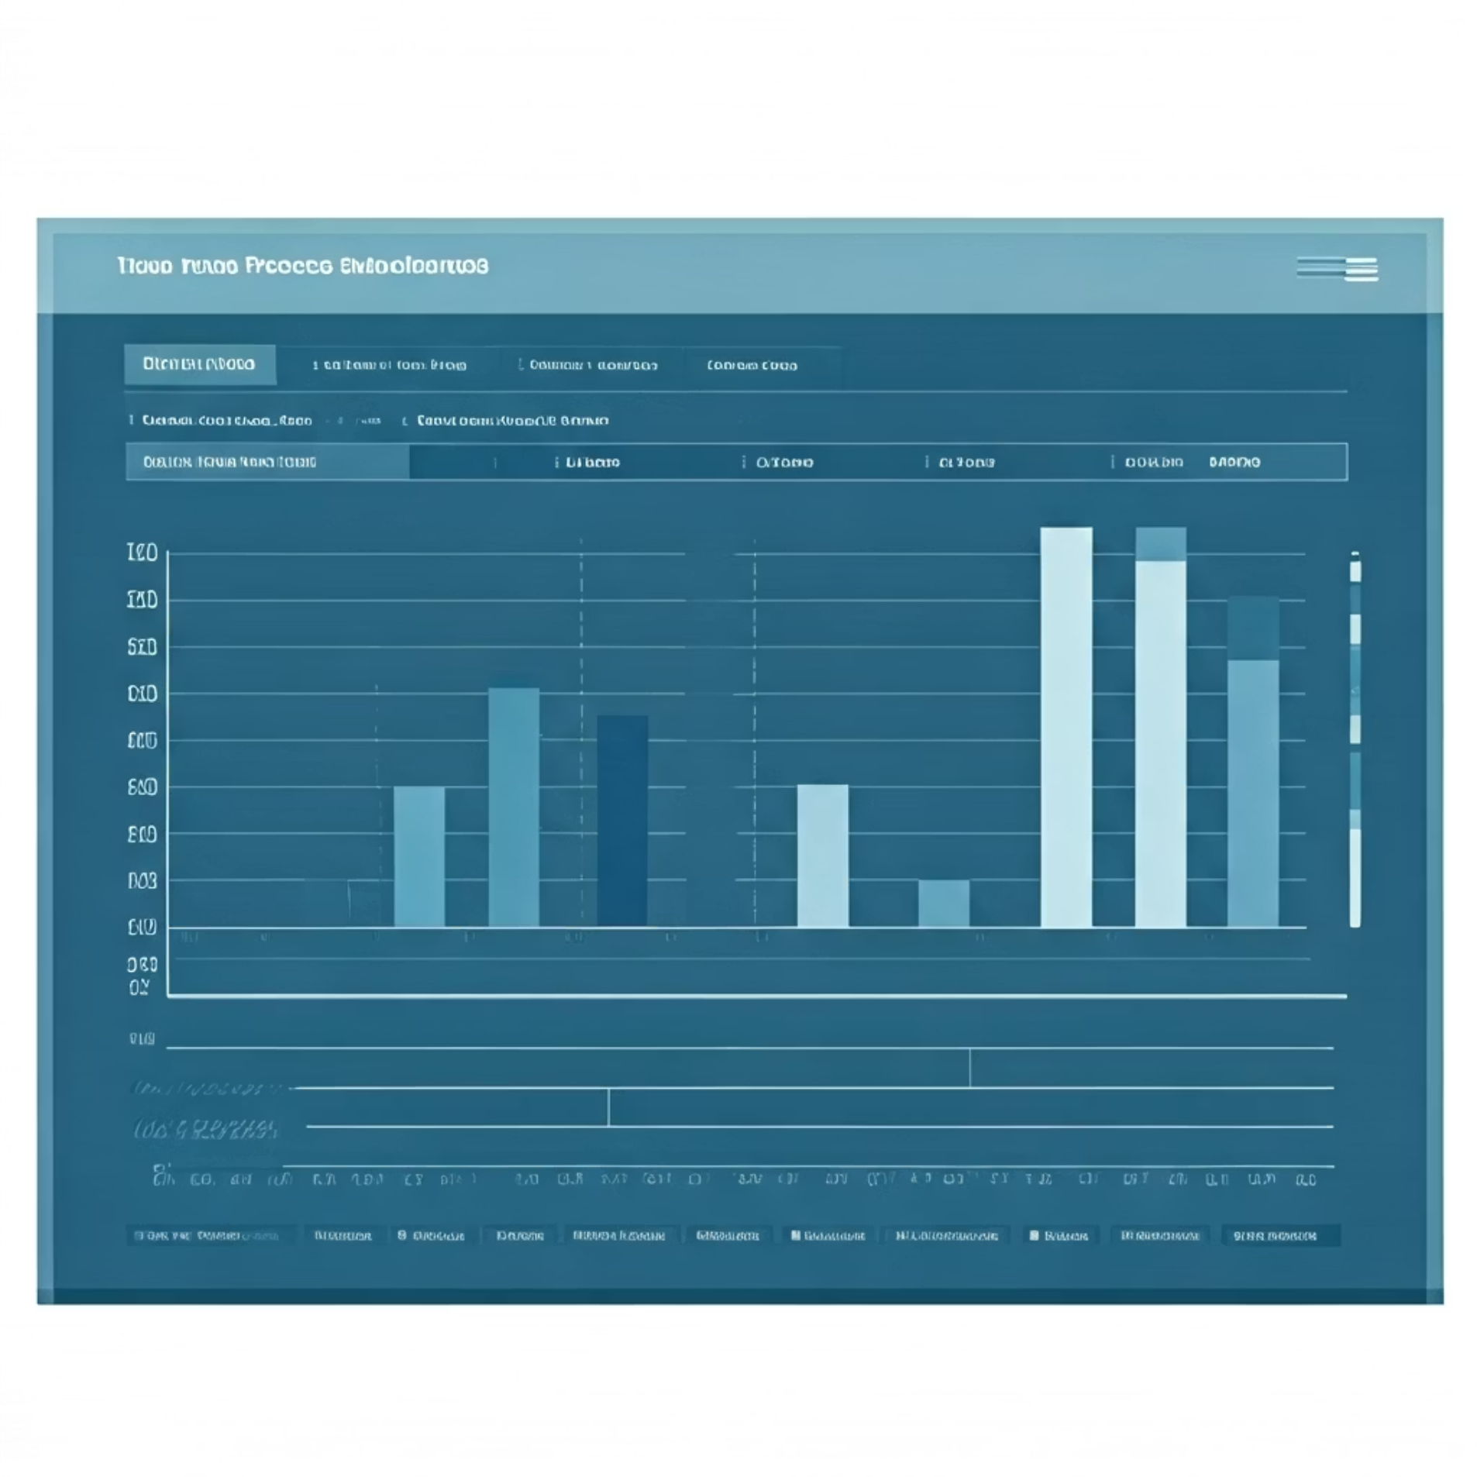
Case Study: Loan Application Process
Challenge
95%
42%
A financial institution's loan application process contained 87 unique activities and generated over 5,000 variants, making analysis impossible.
Coverage
Reduction
Solution
Top 10 variants at Level 1
In average case handling time
Hierarchical decomposition into:
Level 1: 6 major stages
3
Level 2: 24 business activities
Level 3: 87 system events
Bottlenecks
Identified and resolved

Slide 10
Implementation Best Practices
Start with Business Context
Balance Abstraction Levels
Align process levels with business objectives and organizational structure to ensure relevance
Aim for 5-7 activities at highest level, 15-20 at mid-level, and detailed events at lowest level
Use Consistent Grouping Logic
Validate with Subject Experts
Apply consistent rules for grouping activities to maintain analytical integrity across processes
Ensure process abstractions make business sense by consulting with domain specialists
Remember: The goal isn't just simplification—it's creating the right level of abstraction for each analytical purpose while maintaining process integrity.

